Slide 1
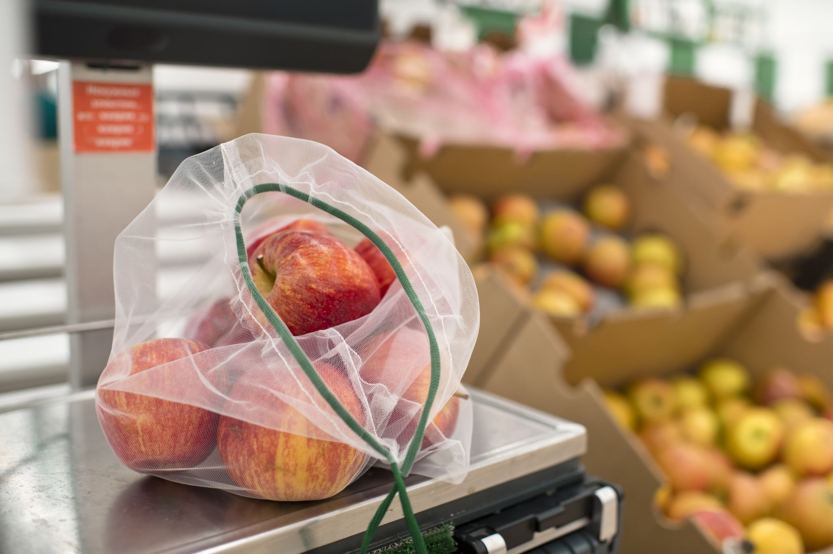

Grocery Shopping System
Omphile Maelagongwe Disemelo 4358375

Slide 2
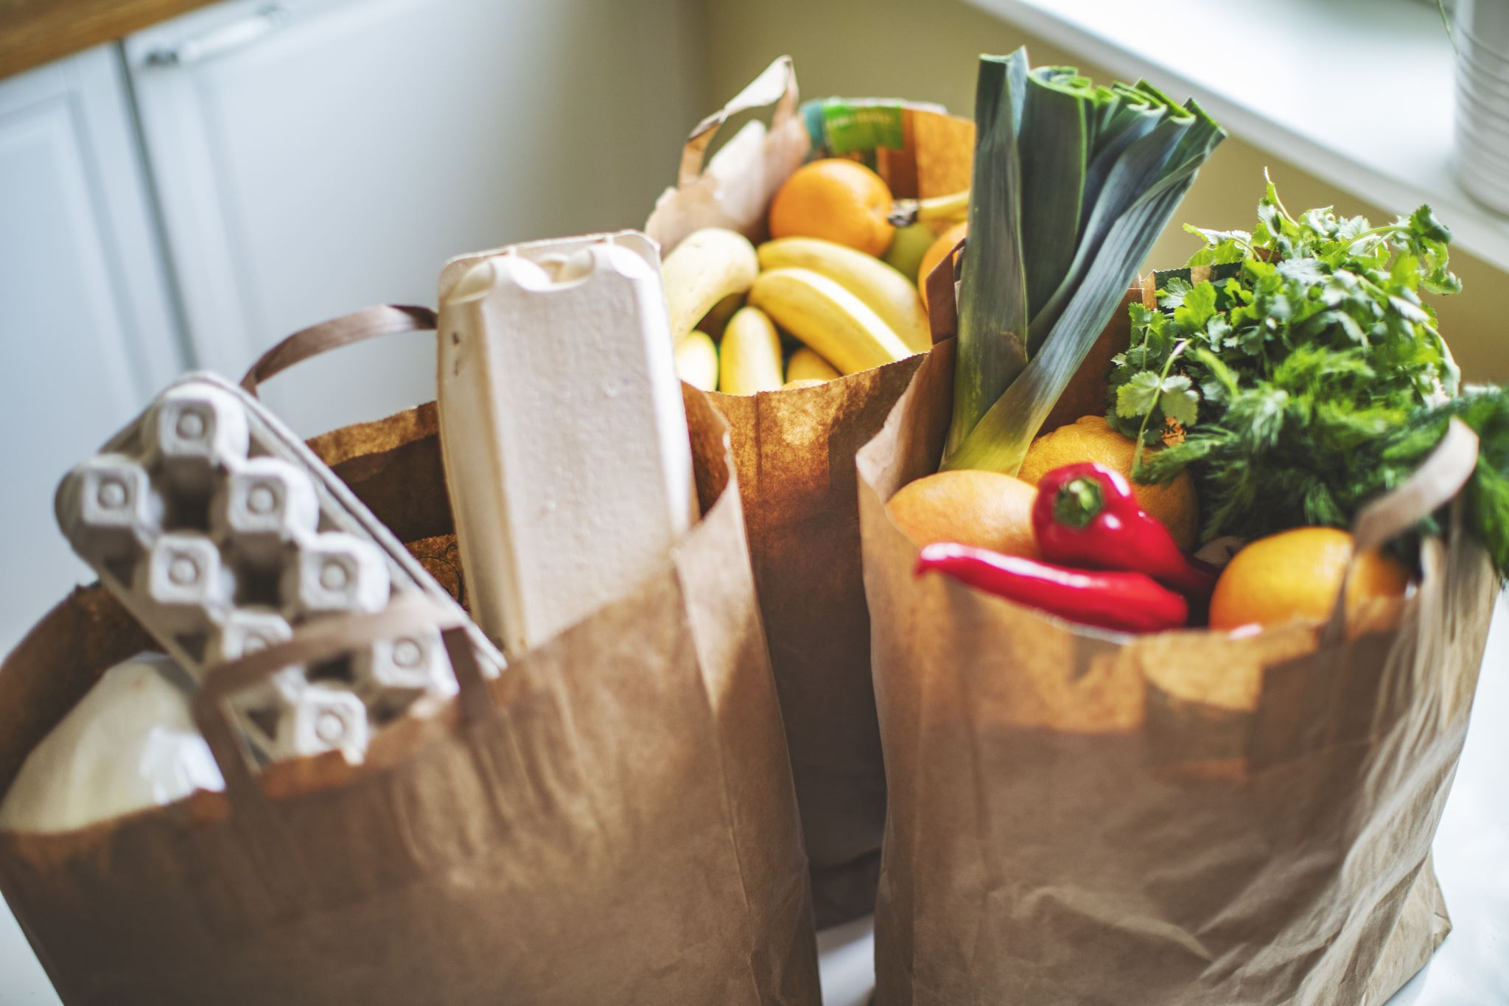
What will we cover?
What inspired the project?
What did the customer require the grocery online system to do for them?
About the project.

Slide 3

Inspiration
Grocery shopping online has become very broad and also has delivery services, but Fresh Finders will not focus on that. A few popular Grocery shopping systems are Checkers Sixty60 and Pick n Pay asap!

Slide 4
The execution of the project
The user must be able to select their groceries. The system will then calculate the sum of the prices of the items selected by the customer.

Slide 5
Product Owner – Product specifications about the Grocery Shopping System.
Scrum Master – gives out tasks to the developers, in charge of ensuring the tasks are done on time.
Developers – Java Development to meet the requirements of the product owner.

